Slide 1
"Digital Media Primer" Yue-Ling Wong,
Copyright (c)2013 by Pearson Education, Inc. All rights reserved.

Slide 2
Chapter 2
Fundamentals of Digital Imaging
Part 4
Color Representation

Slide 3
In this lecture, you will find answers to these questions
What is RGB color model and how does it represent colors?
What is CMY color model and how does it represent colors?
What is HSB color model and how does it represent colors?
What is color gamut? What does out-of-gamut mean?
Why can't the colors on a printout match exactly what you see on screen?

Slide 4
Color Models
Used to describe colors numerically, usually in terms of varying amounts of primary colors.
Common color models:
  RGB
  CMYK
  HSB
  CIE and their variants.

Slide 5
RGB Color Model
Primary colors:
  red
  green
  blue
Additive Color System

Slide 6
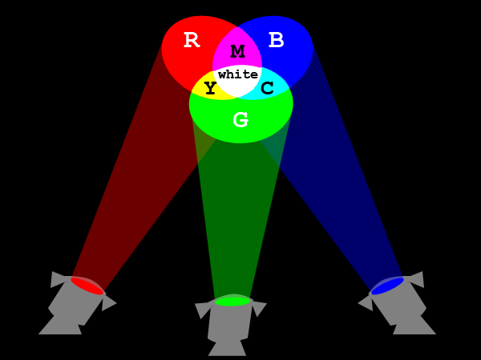
Additive Color System

Slide 7
Additive Color System of RGB
Full intensities of red + green + blue = white
Full intensities of red + green = yellow
Full intensities of green + blue = cyan
Full intensities of red + blue = magenta
Zero intensities of red, green, and blue = black
Same intensities of red, green, and blue = some kind of gray

Slide 8

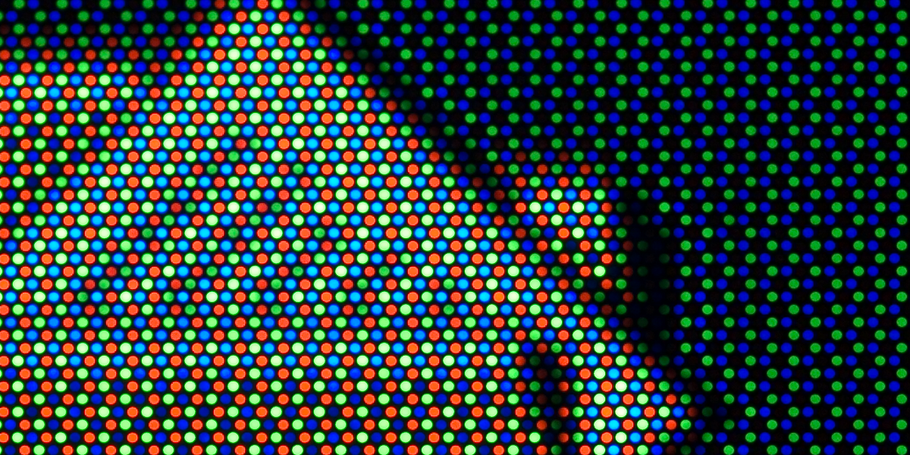
Color Monitors
From a standard CRT monitor screen

Slide 9
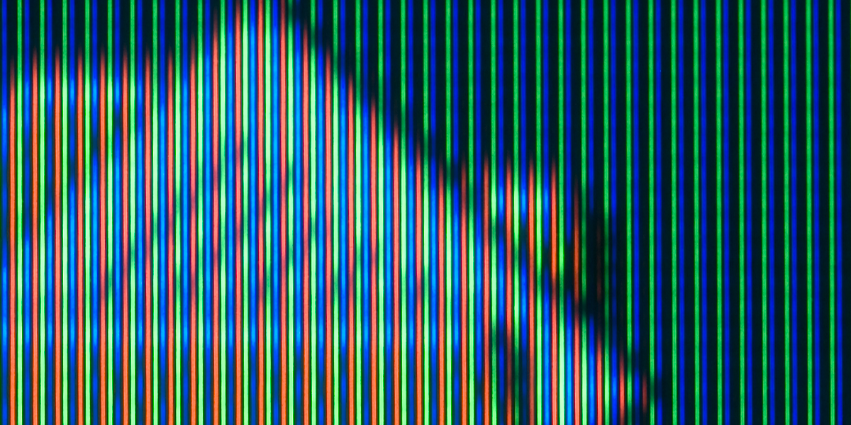
Color Monitors
From a SONY Trinitron monitor screen

Slide 10

Color Monitors
From a LCD screen

Slide 11
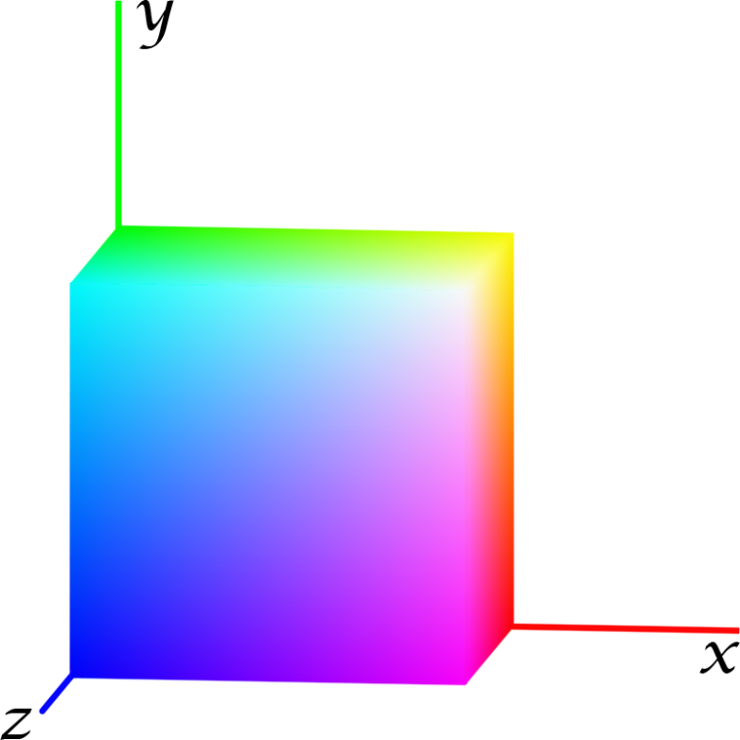
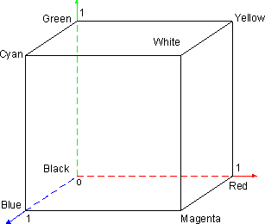
RGB Color Model
depicted graphically as a cube defined by three axes in 3-D space
The maximum value on eachaxis is normalized to 1.

Slide 12
RGB Color Model
x-axis: red values
y-axis: green values
z-axis: blue values

Slide 13
RGB Color Model
The coordinates within the color cube represent the relative intensities of red, green, and blue colors.

Slide 14
RGB Color Model
origin (0,0,0): black

Slide 15
RGB Color Model
(1,0,0): full intensity of red

Slide 16
RGB Color Model
(0,1,0): full intensity of green

Slide 17
RGB Color Model
(0,0,1): full intensity of blue

Slide 18
RGB Color Model
(1,1,1): white

Slide 19
RGB Color Model
(1,1,0): full red + full green = full yellow

Slide 20
RGB Color Model
(1,0,1): full red + full blue = full magenta

Slide 21
RGB Color Model
(0,1,1): full green+ full blue = full cyan

Slide 22
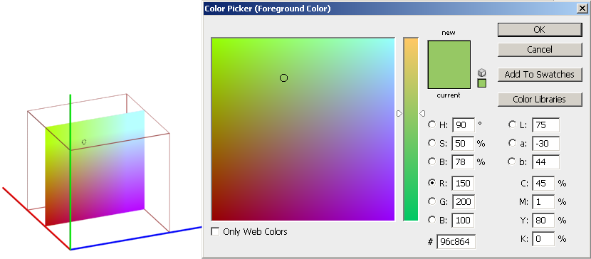
Color Picker
So where is the color whose RGB values are (150, 200, 100) in the RGB cube?

Slide 23
Correlating RGB Color Cube with Color Picker
This is a 2-D slice containing all the colors with red = 150.

Slide 24
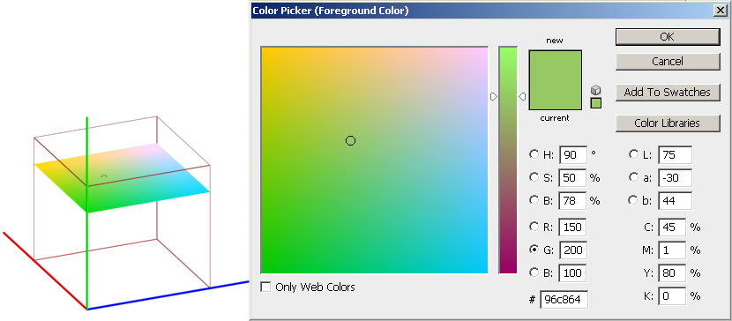
Correlating RGB Color Cube with Color Picker
This is a 2-D slice containing all the colors with green = 200.

Slide 25
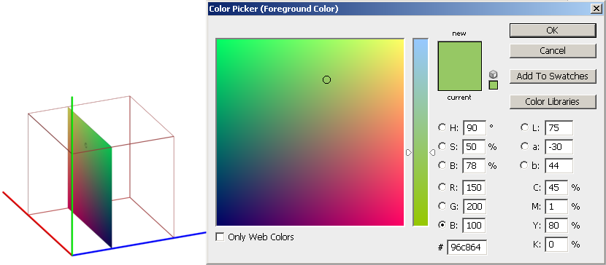
Correlating RGB Color Cube with Color Picker
This is a 2-D slice containing all the colors with blue = 100.

Slide 26
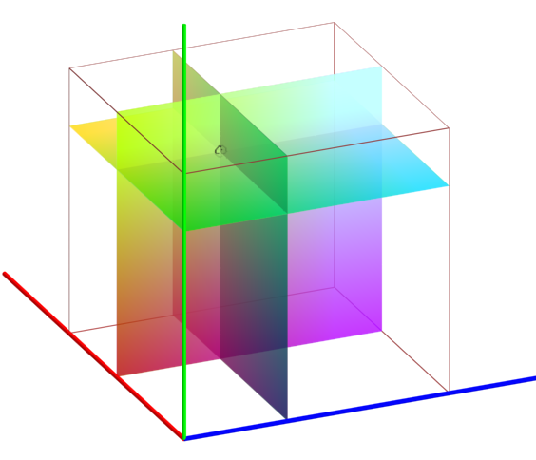
Correlating RGB Color Cube with Color Picker
The color (150, 200, 100) is located in the 3-D space of the RGB color cube.
It is at the intersection of the three 2-D slices.

Slide 27
CMYK Color Model
Primary colors:
  cyan
  magenta
  yellow
  black
Subtractive Color System

Slide 28
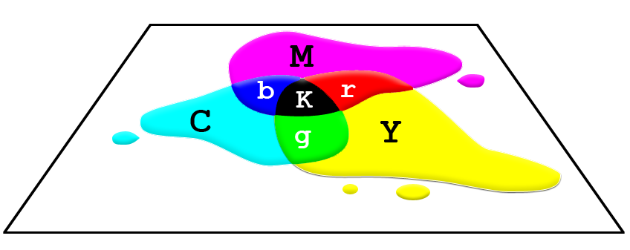
Subtractive Color System of CMY

Slide 29
Subtractive Color System of CMY
Full intensities of cyan + magenta + yellow = black (theoretically, but in practice with inks, it is not full black)
Full intensities of cyan + magenta = blue
Full intensities of cyan + yellow = green
Full intensities of magenta + yellow = red
Zero intensities of cyan, magenta, and yellow = white

Slide 30
HSB Color Model
Hue:
  basic color
  0º to 360º : the location on a color wheel
  in the order of colors in a rainbow
Saturation:
  purity of the color
  how far away from the neutral gray of the same brightness
Brightness

Slide 31
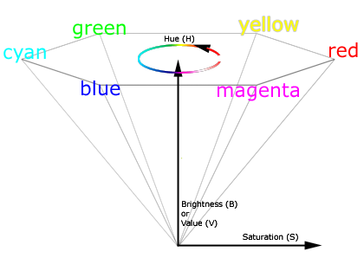
HSB Color Model

Slide 32
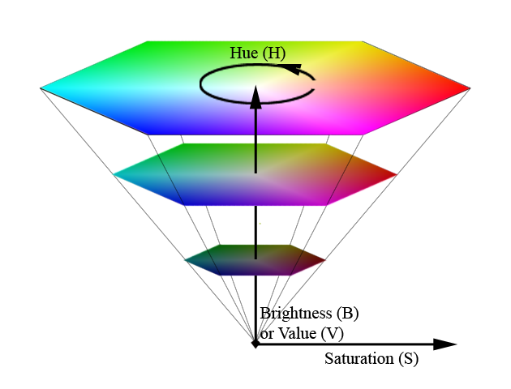
HSB Color Model

Slide 33

HSB Color Model
A slice of the color wheel from the HSB model

Slide 34
HSB Color Model
Matches well with the way humans intuitively think about colors
For example, how would you describe this color?
  Would you think of it in terms of how much red, green, and blue?
  Would you first think of it as a yellowish color and then figure out the lightness and how washed out the color is?

Slide 35
Problems with RGB and CMYK Color Space
Do not encompass all the colors human can see

Slide 36
CIE XYZ Color Model
Primaries:
  X
  Y
  Z
Primaries are not physical colors
Its color space encompasses all the colors human can see.
Normally not used in digital image editing because monitors and printers cannot reproduce all the colors in the CIE XYZ color space anyway.

Slide 37
Color Gamuts
Refers to the range of colors of a specific system or device can produce or capture

Slide 38
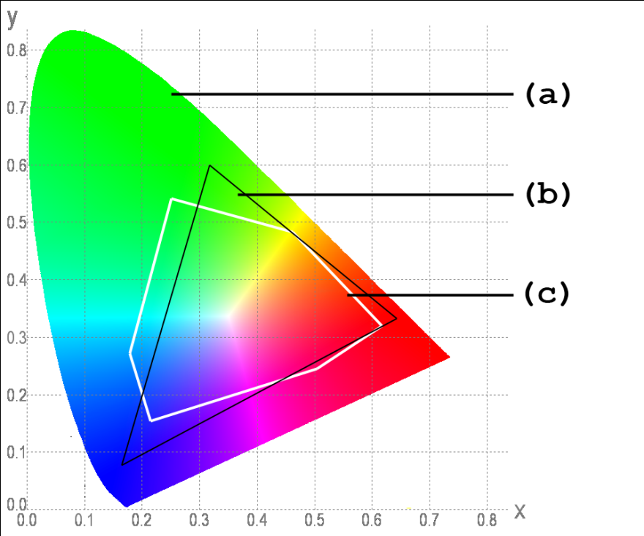
Color Gamuts
Colors that human can see
RGB color gamut of typical CRT monitors
CMYK color gamut of typical inkjet printers

Slide 39
Color Gamuts
Monitors and inkjet printers cannot reproduce all the colors that human can see
Some of the colors that monitors can reproduce cannot be reproduced by inkjet printers. Most of these colors lie at the corners of the color gamut of the monitor, which means these are highly saturated colors.

Slide 40
Identifying Out-of-Gamut Colors in Images
Out-of-gamut colors will not be printed correctly.
In digital image editing programs such as Adobe Photoshop, you can tell whether a color is out of gamut based on your CMYK setting.
Click on the icon to use the closest color in gamut for printing.

Slide 41
Identifying Out-of-Gamut Colors in Images
Out-of-gamut colors will not be printed correctly.
In digital image editing programs such as Adobe Photoshop, you can tell whether a color is out of gamut based on your CMYK setting.

Slide 42
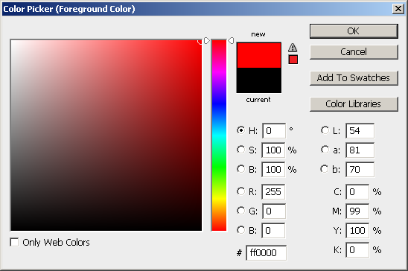
Identifying Out-of-Gamut Colors in Images

Slide 43
Identifying Out-of-Gamut Colors in Images
Click on the icon to replace the out-of-gamut color with the closest color in gamut for printing.

Slide 44
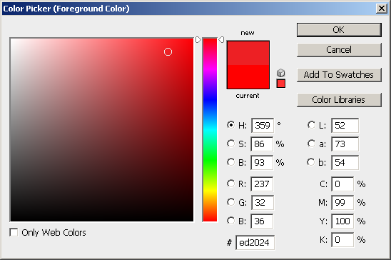
Identifying Out-of-Gamut Colors in Images
The out-of-gamut color is replaced with the closest color in gamut for printing.

Slide 45
Difficulties in Reproducing Colors in Digital Images
Digital devices cannot produce all of the colors visible to human
Difficulties exist in reproducing color across devices
  different devices have different color gamuts
  additive color system for screen display vs. subtractive color system for printing

Slide 46
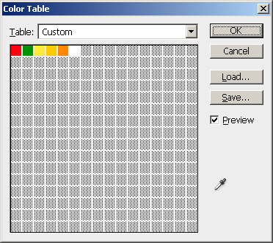

Indexed Color

Slide 47
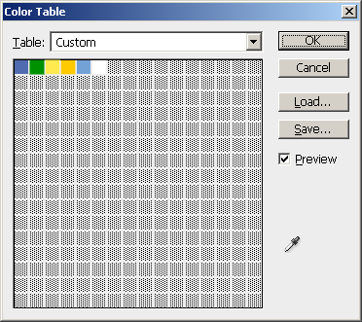

Indexed Color

Slide 48
Review Questions
Note to instructor:
Depending on your preference, you may want to go over the review questions at the end of this lecture as an instant review or at the beginning of next lecture to refresh students' memory of this lecture.

Slide 49
Review Question
What are the primary colors in the RGB color model?
Notes:
red, green, blue

Slide 50
Review Question
What are the primary colors in the CMY color model?
Notes:
cyan, magenta, yellow

Slide 51
Review Question
What are the primaries in the HSB color model?
Notes:
hue, saturation, brightness

Slide 52
Review Question
Which of the following color models take(s) the form of a color cube?
RGB
CMY
HSB
CIE XYZ
Notes:
A and B

Slide 53
Review Question
Which of the following color models take(s) the form of a hexacone?
RGB
CMY
HSB
CIE XYZ
Notes:
C

Slide 54
Review Question
Which of the primaries in the HSB color model takes the form of a color wheel?
Hue
Saturation
Brightness
Notes:
A

Slide 55
Review Question
What is the color mixing method for the RGB color model?
additive
subtractive
Notes:
cyan, magenta, yellow

Slide 56
Review Question
What is the color mixing method for the CMY color model?
additive
subtractive
Notes:
cyan, magenta, yellow

Slide 57
Review Question
What are the RGB values for white?
What are the CMY values for white?
Notes:
RGB: 255, 255, 255
CMY: 0%, 0%, 0%

Slide 58
Review Question
What are the RGB values for black?
What are the CMY values for black?
Notes:
RGB: 0, 0, 0
CMY: 100%, 100%, 100%

Slide 59
Review Question
What are the RGB values for red?
What are the CMY values for red?
Notes:
RGB: 255, 0, 0
CMY: 0%, 100%, 100%

Slide 60
Review Question
What are the RGB values for green?
What are the CMY values for green?
Notes:
RGB: 0, 255, 0
CMY: 100%, 0%, 100%

Slide 61
Review Question
What are the RGB values for blue?
What are the CMY values for blue?
Notes:
RGB: 0, 0, 255
CMY: 100%, 100%, 0%

Slide 62
Review Question
What are the RGB values for yellow?
What are the CMY values for yellow?
Notes:
RGB: 255, 255, 0
CMY: 0%, 0%, 100%

Slide 63
Review Question
Why don't the colors in the printed image look exactly the same as you see on computer screen?
Notes:
Digital devices have different color gamuts. Some colors that can be produce on screen cannot be produced by the printer.

